Slide 1
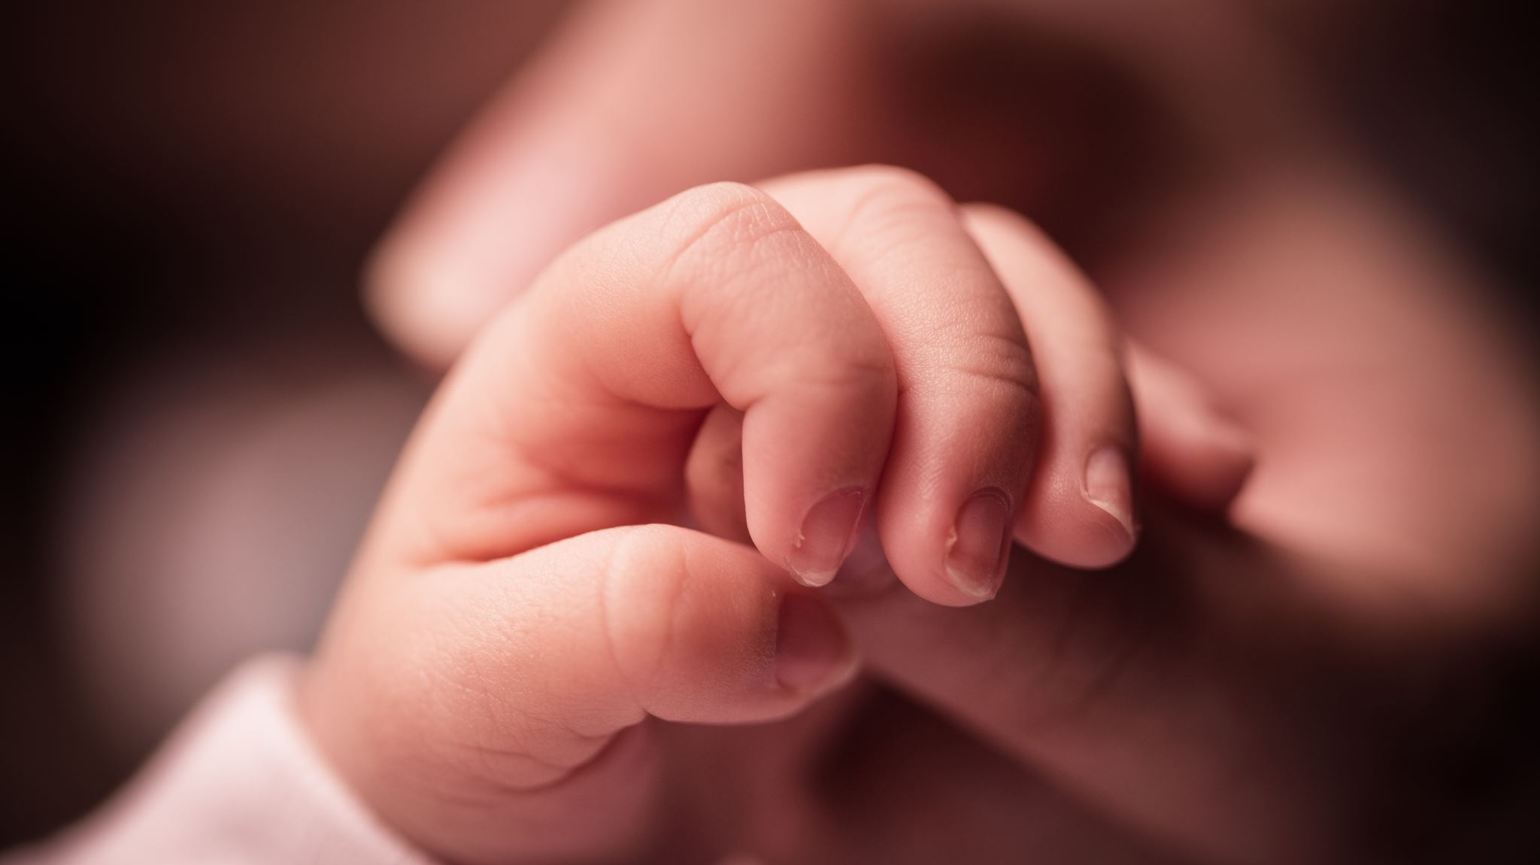
Baby Health Monitoring APP
By Proyecto de Programacia

Slide 2
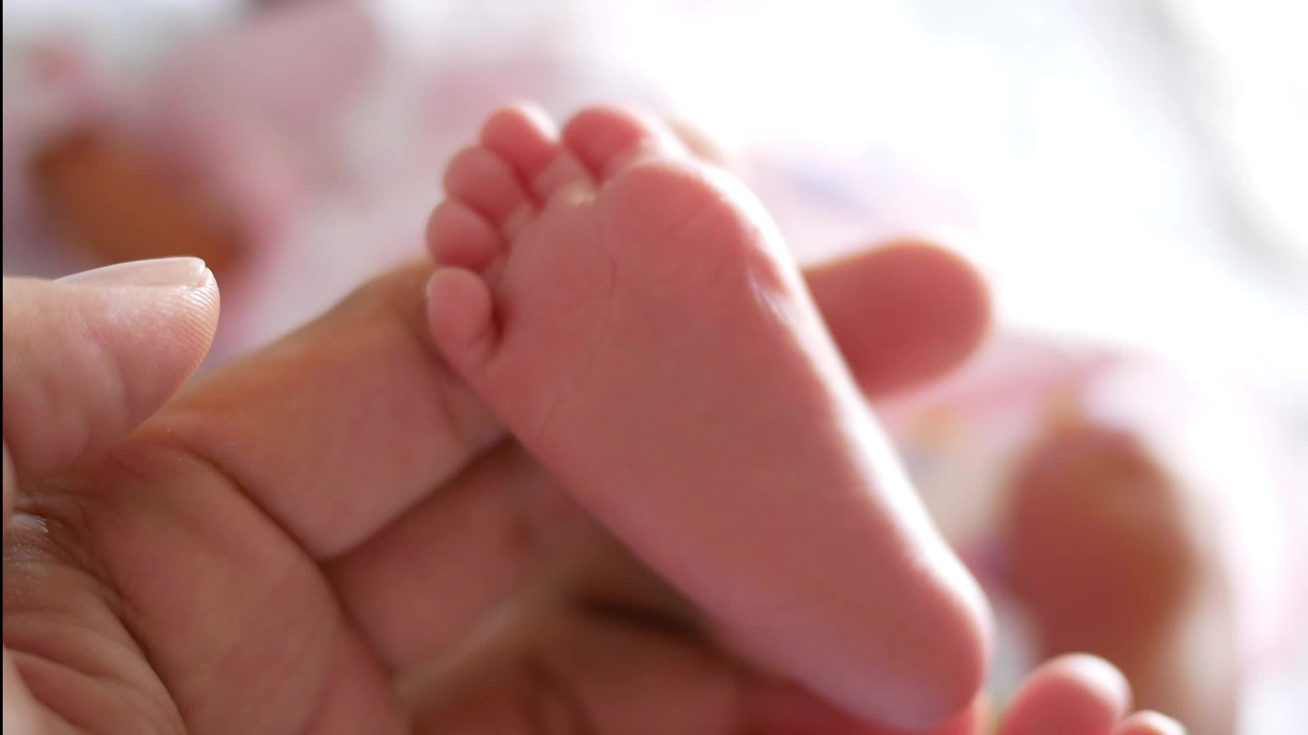
IMMATURE Metabolism in premature babies
Serious Health Consequences
Need Constant Monitoring
Painful Measurement
Notes:
Premature babies or babies that are small but born after the full gestation period have underdeveloped regulatory systems for their blood glucose.
Suffer health consequences similar to diabetes
1. Neuropathy: damage to nerve cells
Leads to loss of sensation in fingers/toes
Leads to blindness
2. Weight loss
Cells can’t use the high levels of glucose

Slide 3
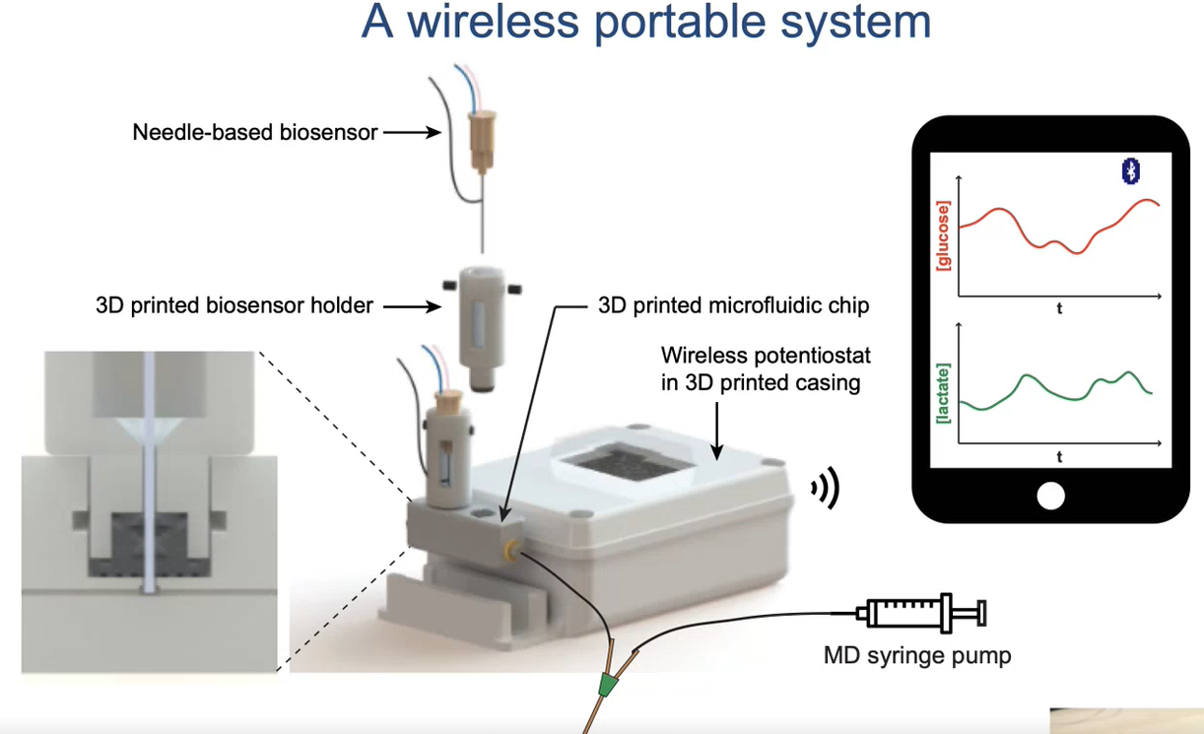
OUR Product
Collect data from the sensor wirelessly and perform signal processing automatically
Present data in various ways to reflect baby's health status
Create a systematic framework to manage data efficiently

Slide 4
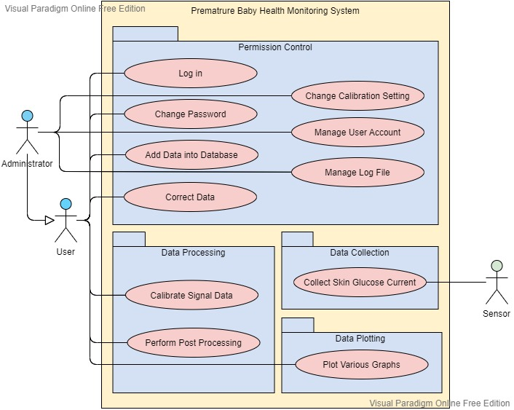
SYSTEM OVERVIEW
Data Collection
Data Processing
Data Plotting
Permission Control

Slide 5
Data Collection
As a [User/Administrator], I want to collect [Baby Hospital Number] so that [these could be used as valuable research resources and related to baby demographics in the future.]
As a [User/Administrator], I want to collect [Glucose Concentration Data] so that [it could be used for real-time monitoring of baby’s health status.]
As a [User/Administrator], I want to collect [Skin Glucose Current Data] so that [it could also be used for real-time monitoring after calibration.]
As a [User/Administrator], I want to collect [Calibration Parameters] so that [the concentration curve could be adjusted and plotted more accurately.]
As a [User/Administrator], I want to collect [Lag Time] so that [graphs could be correctly plotted and presented accurately.]
Notes:
(1) Glucose Concentration Data: discrete concentration value entered by User/Administrator
(2) Skin Glucose Current Data: discrete signal value directly from the sensor
(3) Skin Glucose Concentration Data: discrete concentration value calculated by calibrating Skin Glucose Current Data
(3) Timestamp: in the format 'date/hour/minute/second'. – makesure you define a format that you can decode to use to plot the graph. The timestamp is set as default to the time of entering, but should include the possibility of applying a correction factor (e.g. 1/5/10 minutes ago) in case log was not immediate after measurement.
(4) Event: Free text comment which illustrate the action performed at certain time point, every event information is time stamped.
(6) Lag Time: the time between sample leaving the body and analyzed by the sensor. This is set to 10min as default but could be changed with the administration priority

Slide 6
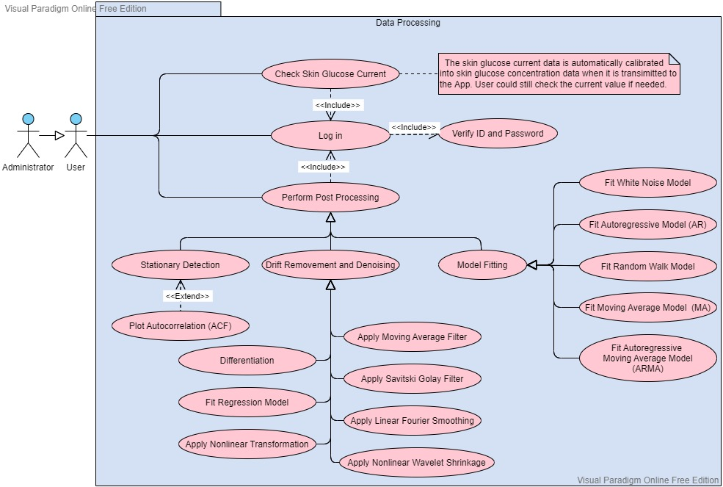
Data Processing
As a [User/Administrator],
I want to [calibrate the signal data.]
As a [User/Administrator],
I want to [perform post processing.]

Slide 7
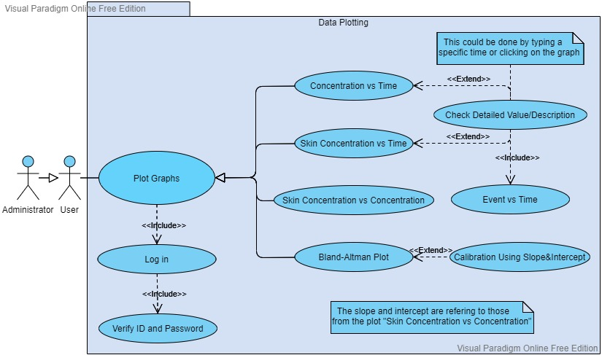
Data Plotting
As a [User/Administrator],
I could [ check detailed value and description.]
As a [User/Administrator],
I want to plot [Glucose Concentration vs Time.]
As a [User/Administrator],
I want to plot [Skin Glucose Concentration vs Time.]

Slide 8
Data Plotting
As a [User/Administrator],
I want to plot [Event vs Time (into Concentration Plot).]
As a [User/Administrator],
I want to plot [Skin Glucose Concentration vs Glucose Concentration.]
As a [User/Administrator],
I want to plot [Bland-Altman Plot for Glucose Concentration and Skin Glucose Concentration.]

Slide 9
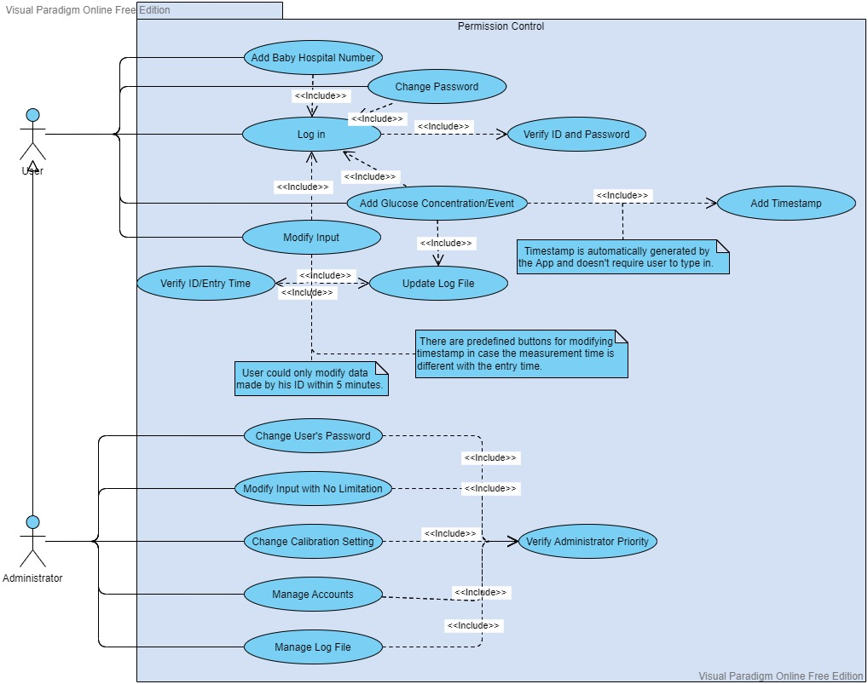
Permission control
As a [User/Administrator],
I could [log in using a unique ID and password.]
As a [User/Administrator],
I could [change my password.]
As a [User/Administrator],
I could [add Glucose Concentration/Event.]
As a [User/Administrator],
I could [modify input with ID within 5min.]
Notes:
(1) As a [User/Administrator], I could [log in using a unique ID and a matched password] so that [only users given permission could use this app.]
(2) As a [User/Administrator], I could [change my password] so that [I could have more safety protection for my account.]
(3) As an [Administrator], I could [change other User’s password (User only)] so that [I could manage the organization and help User in case they forget the password.]
(4) As a [User/Administrator], I could [add Blood Glucose Measurement Information with Timestamp and User ID (stored for data transparency, but not displayed)] so that [it could be compared against skin glucose measurements.]
(5) As a [User/Administrator], I could [add Event Information with Timestamp and User ID (stored for data transparency, but not displayed)] so that [it could be analyzed with concentration data and might be able to explain some unusual trends in the plot.]
(6) As a [User/Administrator], I could [correct the input data made by my ID within a certain time interval (5min) (and reflect such change in a change log)] so that [any errors could be corrected while the database is under protected.]
(7) As a [User/Administrator], I could [check the detailed description of event or concentration at certain time point] by [typing in a specific time or clicking on the time graph] so that [I could understand more details with higher accuracy.]
(8) As an [Administrator], I could [correct any input data made by any User ID with no time limit (and reflect such change in a change log)] so that [the data stored in the database is well organized and remains accurate.]
(9) As an [Administrator], I could [change the Calibration Setting] so that [a more accurate prediction could be achieved from the modified calibration curve.]
(10) As an [Administrator], I could [add/delete other User’s account] so that [I could manage the organization.]
(11) As an [Administrator], I could [check and manage the log file] so that [any operations done to the database could be recorded and well managed.]

Slide 10
Permission control
As a [Administrator],
I could [change other User's password.]
As a [Administrator],
I could [modify input with no limitation.]
As a [Administrator],
I could [change calibration setting.]
As a [Administrator],
I could [manage log file.]
Notes:
(1) As a [User/Administrator], I could [log in using a unique ID and a matched password] so that [only users given permission could use this app.]
(2) As a [User/Administrator], I could [change my password] so that [I could have more safety protection for my account.]
(3) As an [Administrator], I could [change other User’s password (User only)] so that [I could manage the organization and help User in case they forget the password.]
(4) As a [User/Administrator], I could [add Blood Glucose Measurement Information with Timestamp and User ID (stored for data transparency, but not displayed)] so that [it could be compared against skin glucose measurements.]
(5) As a [User/Administrator], I could [add Event Information with Timestamp and User ID (stored for data transparency, but not displayed)] so that [it could be analyzed with concentration data and might be able to explain some unusual trends in the plot.]
(6) As a [User/Administrator], I could [correct the input data made by my ID within a certain time interval (5min) (and reflect such change in a change log)] so that [any errors could be corrected while the database is under protected.]
(7) As a [User/Administrator], I could [check the detailed description of event or concentration at certain time point] by [typing in a specific time or clicking on the time graph] so that [I could understand more details with higher accuracy.]
(8) As an [Administrator], I could [correct any input data made by any User ID with no time limit (and reflect such change in a change log)] so that [the data stored in the database is well organized and remains accurate.]
(9) As an [Administrator], I could [change the Calibration Setting] so that [a more accurate prediction could be achieved from the modified calibration curve.]
(10) As an [Administrator], I could [add/delete other User’s account] so that [I could manage the organization.]
(11) As an [Administrator], I could [check and manage the log file] so that [any operations done to the database could be recorded and well managed.]

Slide 11

THANK YOU

